Slide 1
Abstractive Opinion Tagging
Advisor: JIA-LING, KOH
Source: WSDM,21
SPEAKER: Rui Ze Fang
DATE: 2021/11/23

Slide 2
Outline
Introduction
Method
Experiment
Conclusion

Slide 3
Introduction
Target
Rank
Price
1
Food
3
……
Service
2
Item
environment
4
Reviews
(Input)

Slide 4
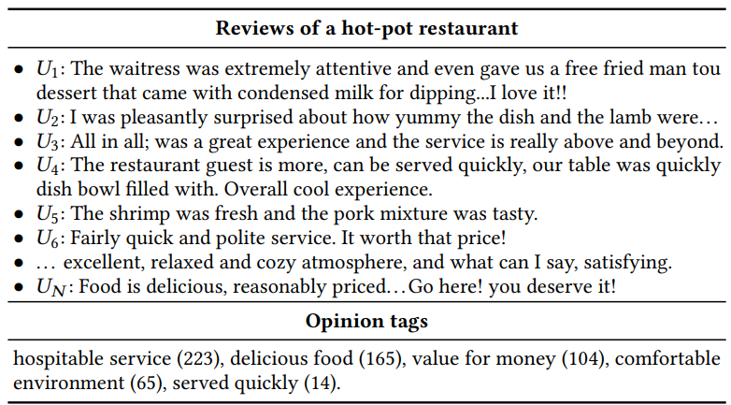
Introduction

Slide 5
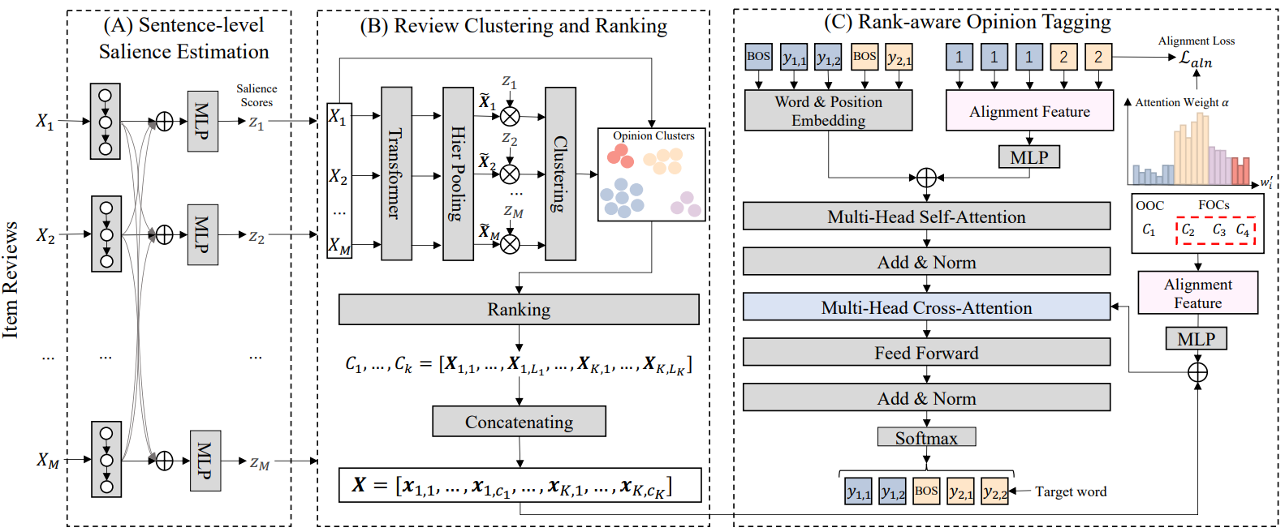
Method

Slide 6
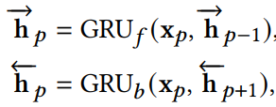
Sentence-level Salience Estimation

Slide 7
Sentence-level Salience Estimation

Slide 8
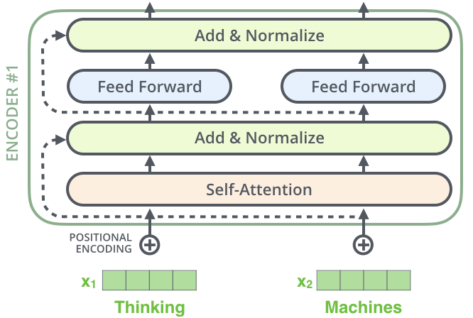
Review Clustering and Ranking
$$h_{x_{1}}$$
$$h_{x_{2}}$$

Slide 9
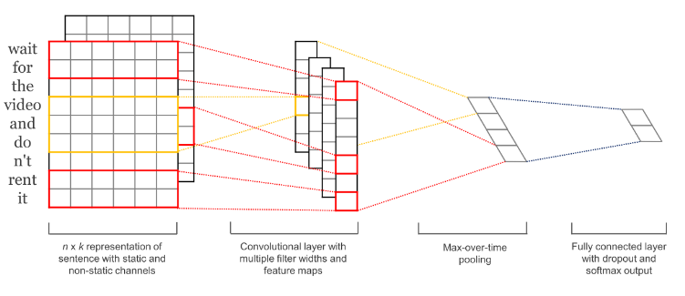
Hierarchical pooling
$${\tilde{X}}_{i}$$
Sentence representation
k-means clustering
$X_{k,i }$ : 𝑖-th review in the 𝑘-th opinion cluster
$x_{k,p}$ :𝑝-th word in the 𝑘-th opinion cluster

Slide 10
Rank-aware Opinion Tagging

Slide 11
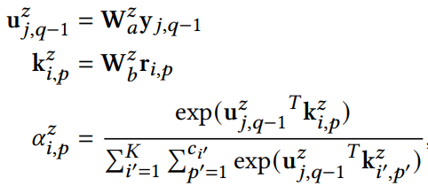
Rank-aware Opinion Tagging

Slide 12
Rank-aware Opinion Tagging
$$c_{j,q}$$

Slide 13
Rank-aware Opinion Tagging

Slide 14
Loss function
Notes:
λ都設為1

Slide 15
Experiment
Pr: present tags
Ab: absent tags
MTN: max tag number
MTL: max tag length

Slide 16
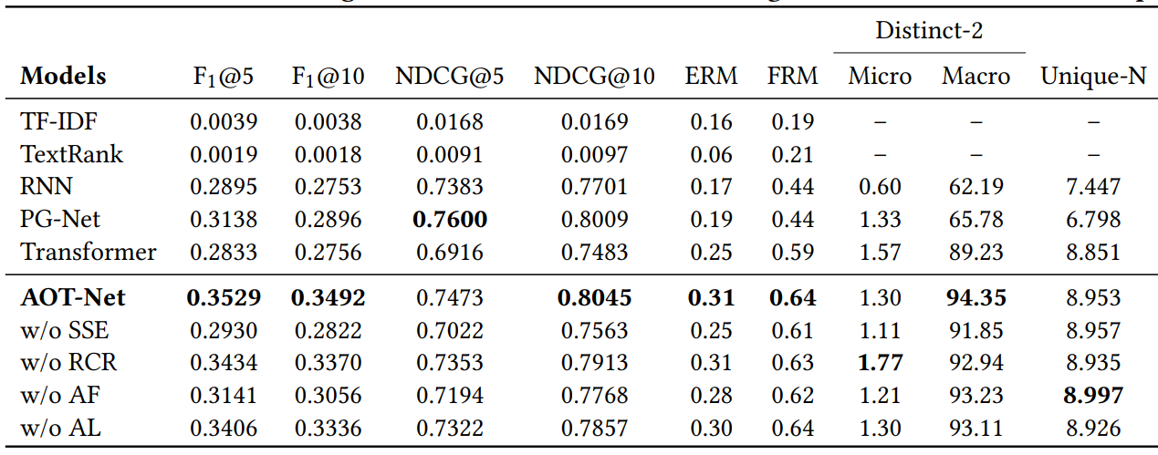
Experiment

Slide 17
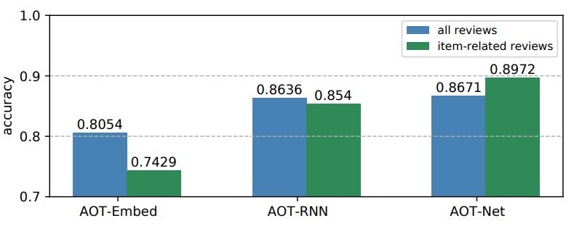
Experiment

Slide 18
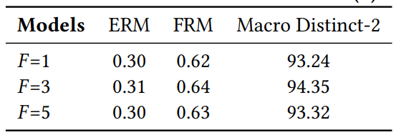
Experiment

Slide 19
Conclusion
AOT-Net generates more concise opinion tags
the ranked lists of generated opinion tags help users distinguish products with very similar aspects.
Future work
deep clustering network instead of 𝑘-means algorithm
pre-trained language models could provide more power to enhance our sentence salience estimation

